Slide 1
Wiring for DMXW High Power LED

Slide 2
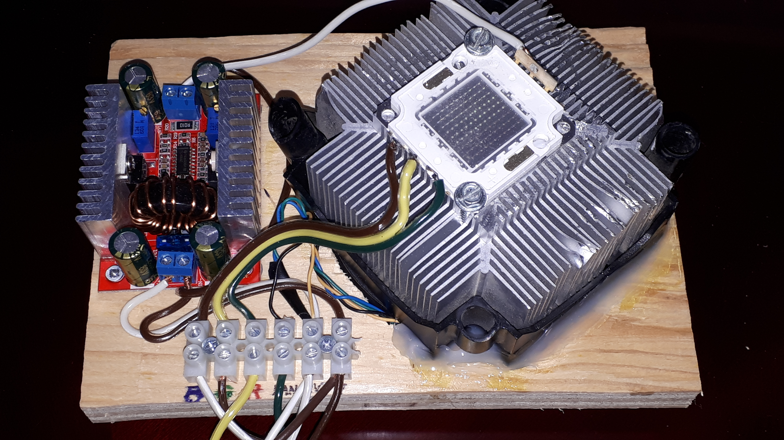
Akozon Boost Module 400W DC-DC Converter (constant
Voltage, constant current??) power supply to boost 12 Vdc
to 36 Vdc. (Poorly documented.) Draws about 12 Vdc, 4.1 A.
[Amazon.ca]
RGB LED (100W)
- effective power is 40W
(appox equivalent to 300W
Incandescant, 4000 lumens)
- 30 – 36 Vdc
- total current draw with DC-DC
booster is approx 36 Vdc, 1.12A
DMXW - Red
DMXW - Fan
DMXW - Green
+12 Vdc
DMXW - Blue
GND
Over-engineered heat sink with
12 Vdc cooling fan. (Discarded
PC cooling fan.)

Slide 3
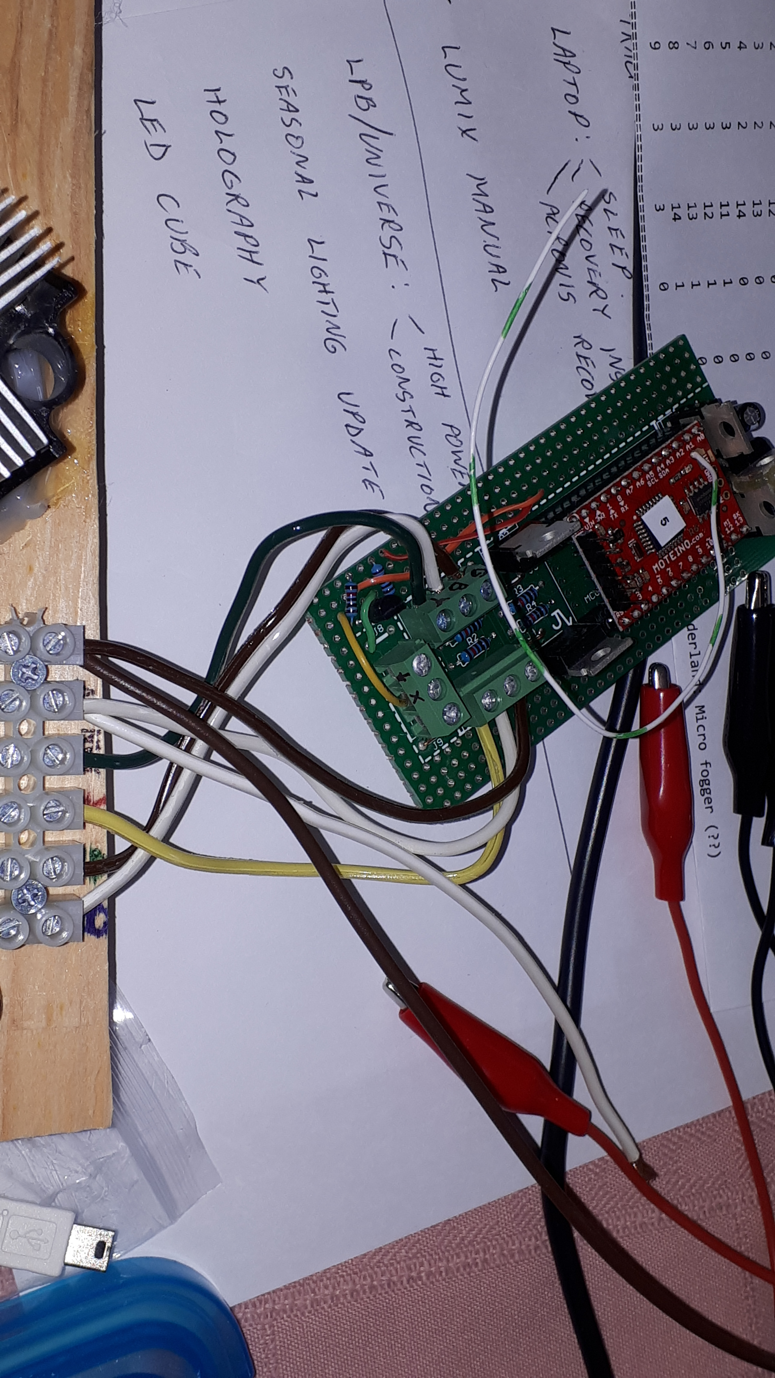
GND
+12 Vdc
DMXW - Green
DMXW - Red
DMXW - Blue
DMXW - Fan

